Slide 1
Growing Older Planning Ahead

Slide 2
Hello!

Slide 3
Who we are
Healthwatch speaks up for people who use health and care services.

Slide 4
Who we are
We find out what people like about services and what could be made better.

Slide 5
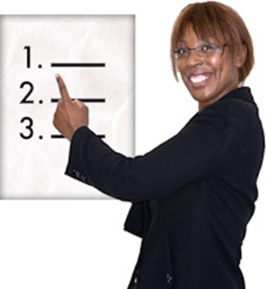
What we will talk about today

Slide 6
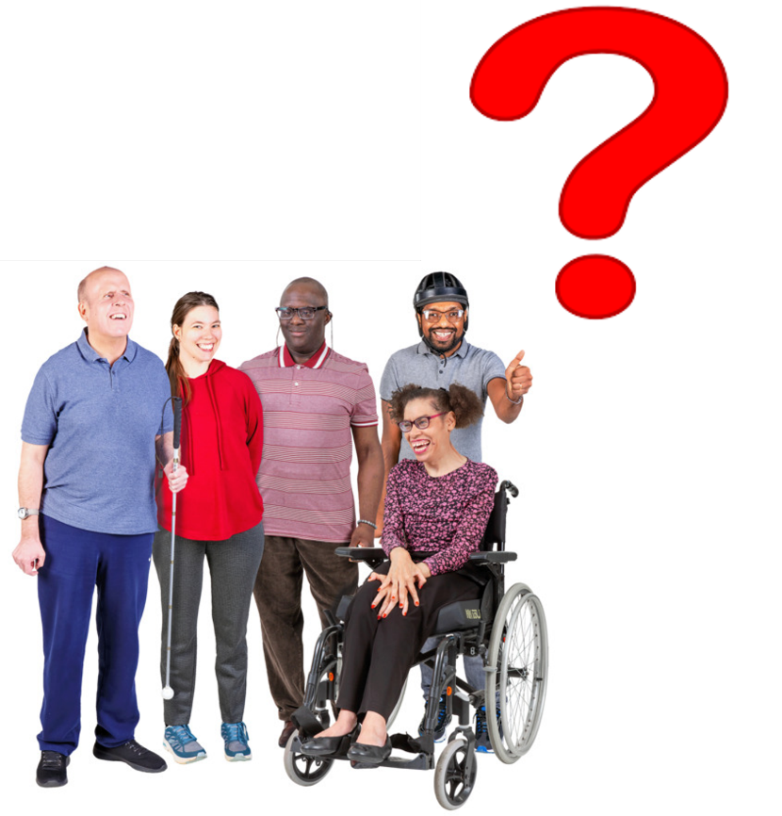
What we will talk about
We want to ask you some questions about your life now and when you get older.

Slide 7
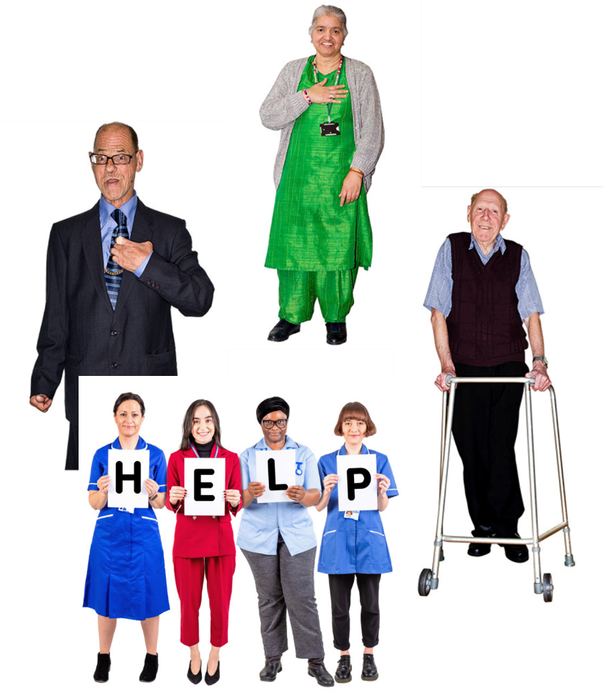
What we will talk about
This will help the NHS and other services decide how to help you as you get older.

Slide 8
What we will talk about
We will write a report about what you say. We will not use your name.

Slide 9
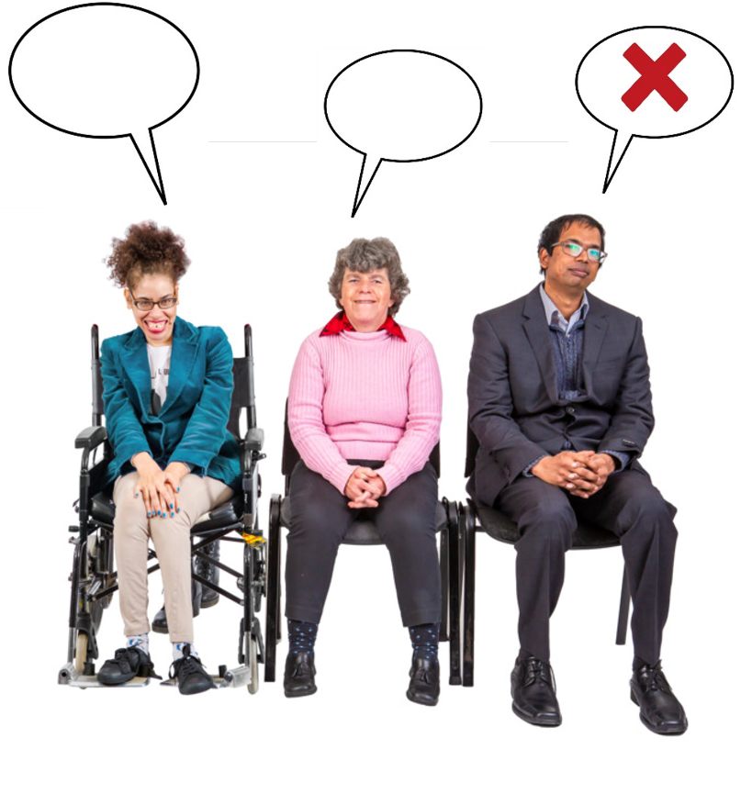
What we will talk about
You do not have to answer all the questions if you do not want to.

Slide 10
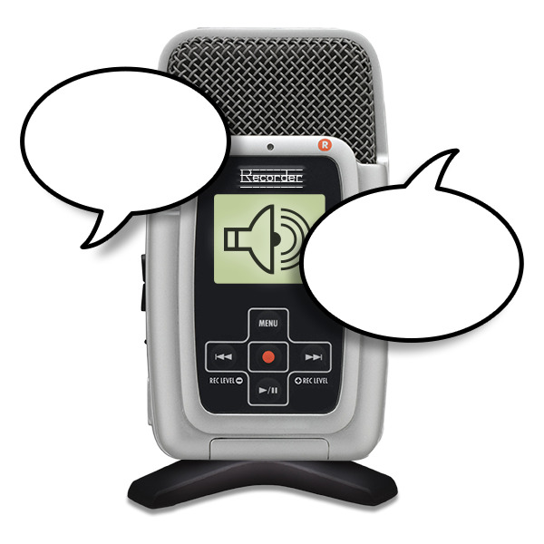
What we will talk about
We will record the meeting. This helps us to remember what people said.

Slide 11
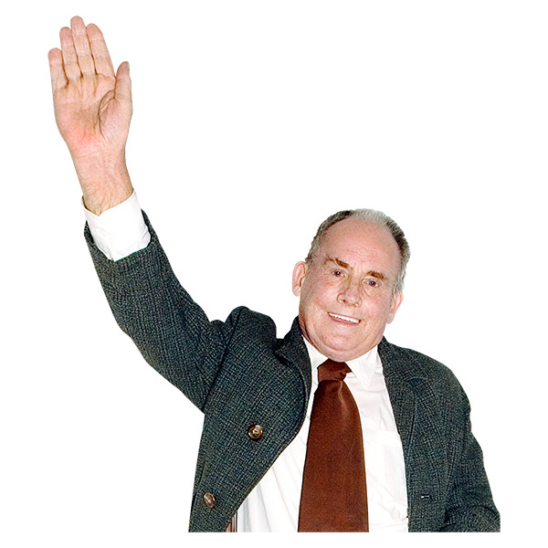
Any questions?

Slide 12
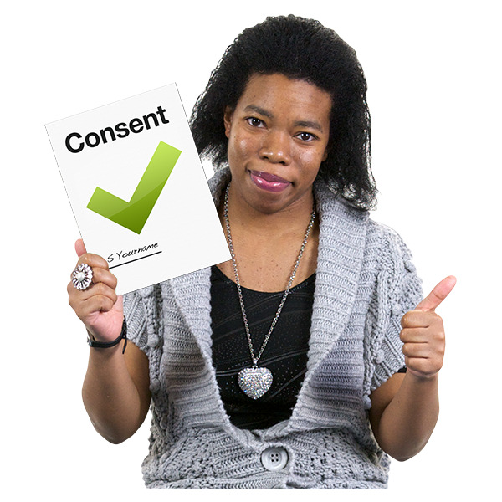
What we will talk about
Please fill in the consent form before we start. The form tells us if you are ok to take part.

Slide 13
Your home
Who do you live with now?

Slide 14
Your home
What do you like about where you live now?

Slide 15
Your home
Has anyone talked to you about where you might like to live in the future?

Slide 16
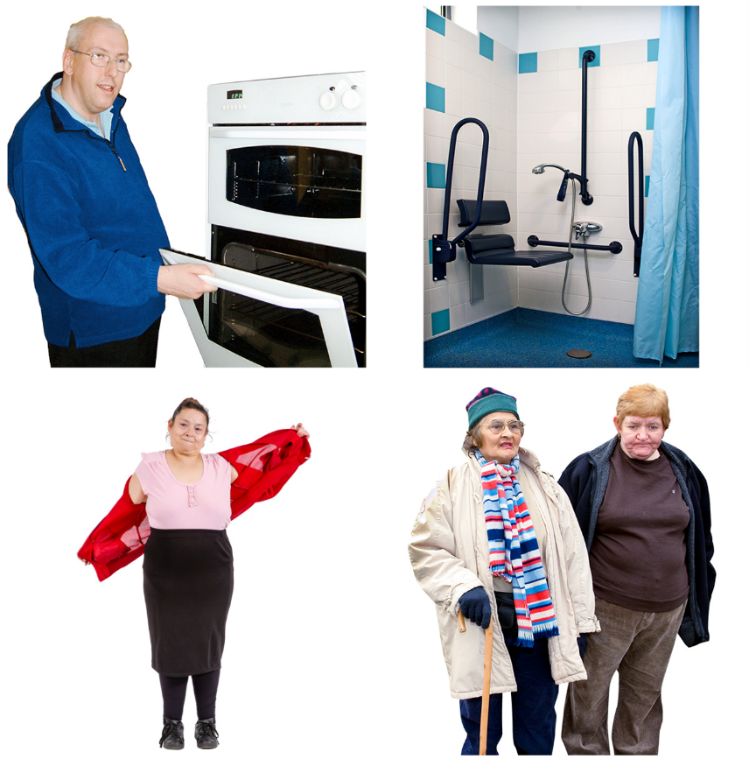
Help and support
What do you need help with now?

Slide 17
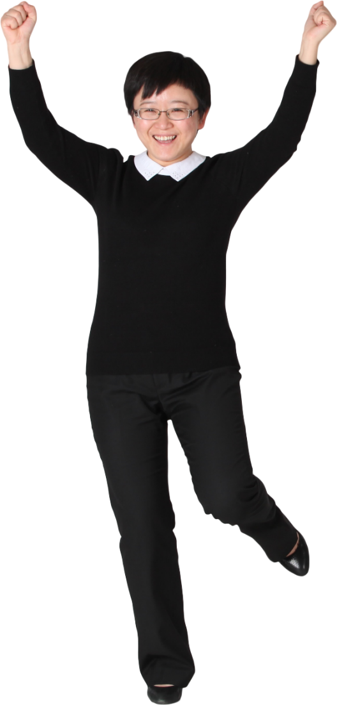
Feelings
What things make you happy?

Slide 18
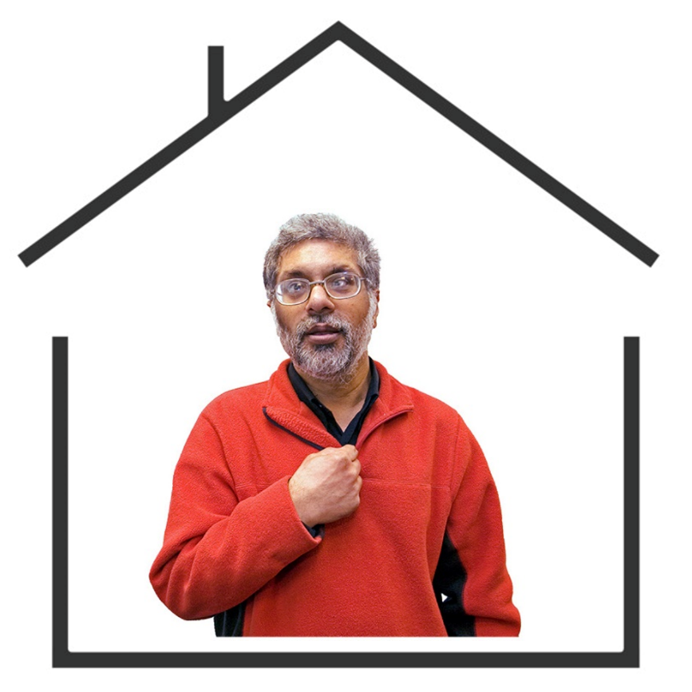
Your own place
Would you like your own place to live in?

Slide 19
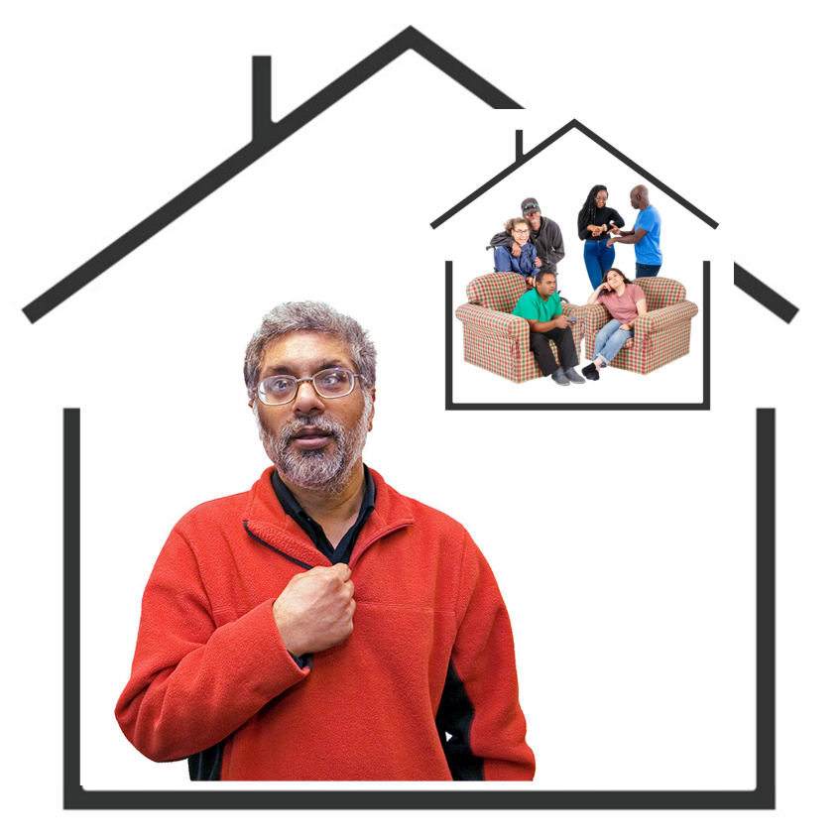
Your own place
If you did have your own place, would you like someone to live with you?
If you said yes, who would this be?

Slide 20
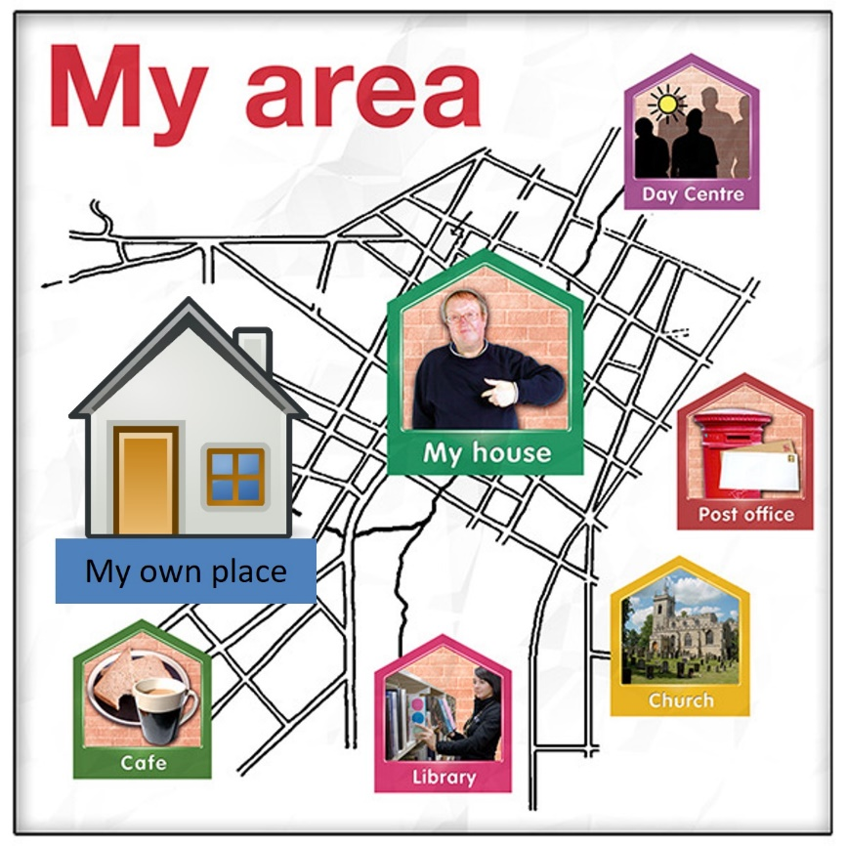
Your own place
Would you like to live close to where you live now?
Where would this be?

Slide 21
Help and support
If you moved to your own home, what help would you need?

Slide 22
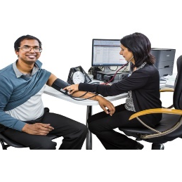
Health Check
Have you been asked to go for an Annual Health Check?
If you said yes, did you go?

Slide 23
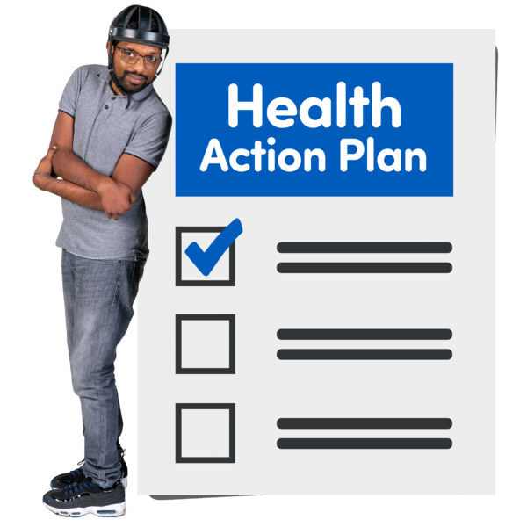
Health Check
Do you have a Health Action Plan?
If you said yes, tell us three things your Health Action Plan helps you to do.

Slide 24
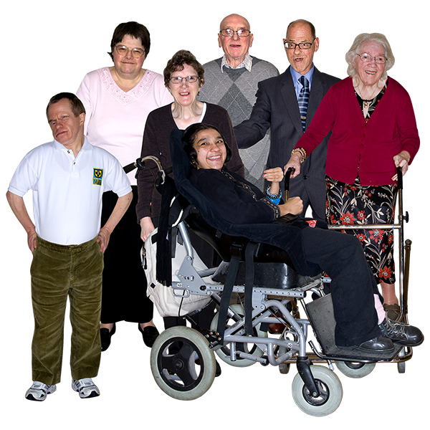
Health Check
Do you need any other help with your health as you get older?

Slide 25
Any questions?

Slide 26
Thank you

